Slide 1
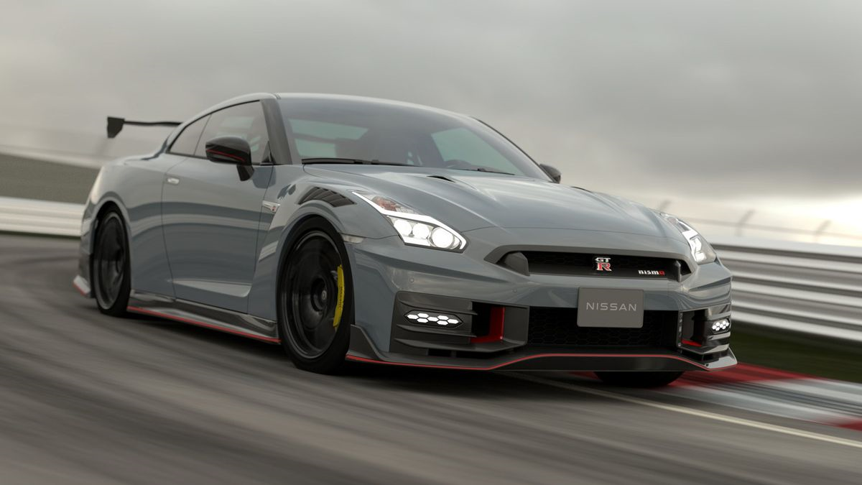
The Nissan GT-R 35
The Legend of JDM World

Slide 2
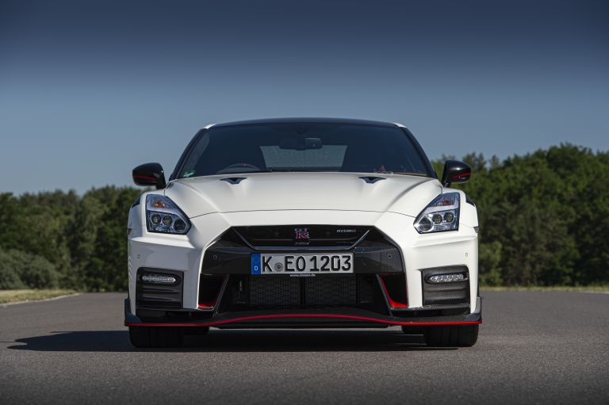
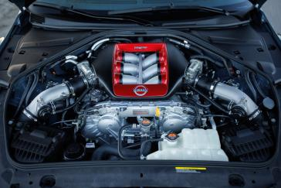
The First Nissan GT-R R35 was presented at the Tokyo Motor Show in 2007 and the it is six Gen of
GTR-Line up.
The Power-Train on this beast has 3.8 Liters V6 Twin Turbo ,it can performed 0 to 100 miles in 2.8s and it has all wheel drive system

Slide 3
The car is used in MortorSport, notably winning championships in the FIA GT1 Championship,Super GT and GT3 Racing. It is well received among enthusiasts and automotive publications as well
Despite being one of the fastest production cars, it has won numerous notable accolades such as the World Performance Car of The Year among many others.

Slide 4
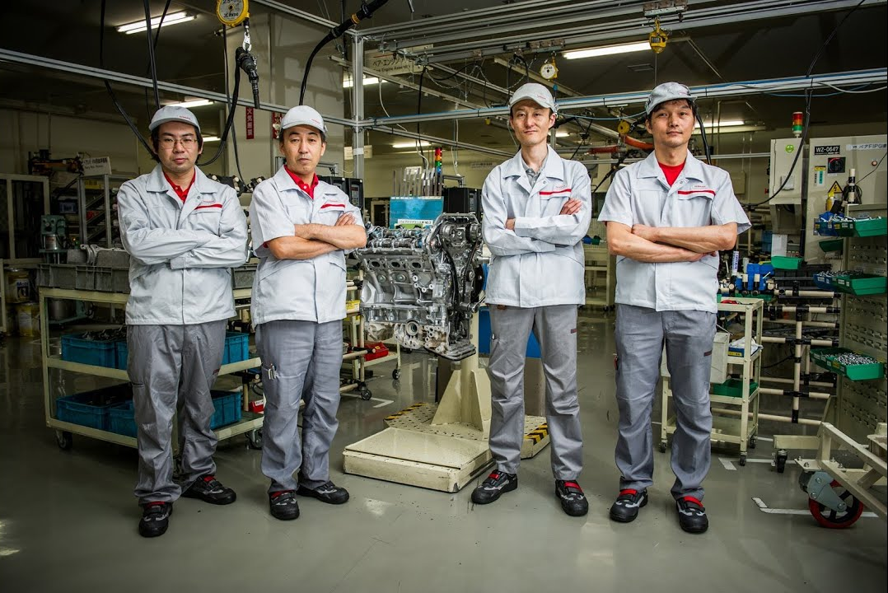
Takumi Kurosawa, Tsunemi Ooyama, Izumi Shioya and Nobumitsu Gozu are the only people who assemble the 545hp twin-turbo V6 engines that power the GT-R by hand. They are all Japanese and are respectfully called “takumi”, a word that describes a master craftsman who has perfected his skills over many years of hard work and dedication.

Slide 5
Thank For Watching

